Slide 1
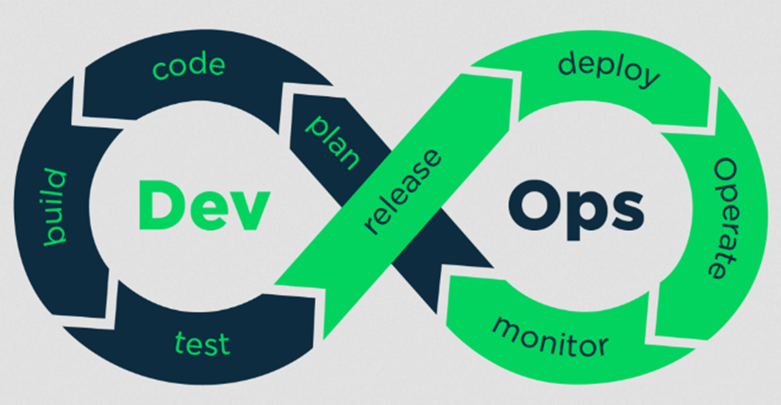
Where to start DevOps?

Slide 2
Git

Slide 3


Version Control System

Slide 4
Git - Version Control System
A version control system (VCS) is a software tool that helps manage changes/versions to source code or any set of files over time.
It allows developers (or teams of developers) to track modifications to files, revert to previous versions, compare changes over time, and collaborate effectively on projects.
Key features of a version control system include:
Tracking Changes: It records every change made to files, along with who made the change and when.

Slide 5
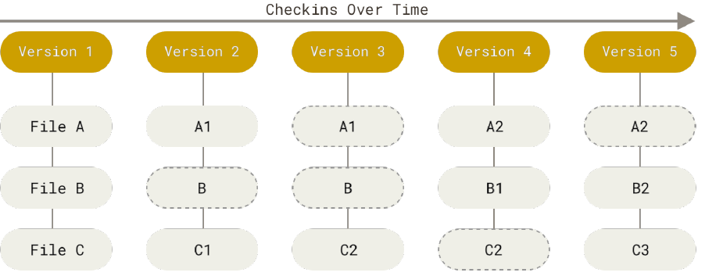
Git - Version Control System

Slide 6

Git - Version Control System
Reverting Changes: It allows reverting files or the entire project to a previous state, which is useful for undoing mistakes or going back to a stable version.

Slide 7
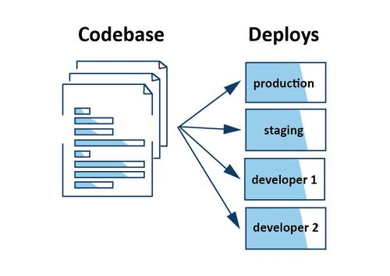
Git - Version Control System
Branching and Merging: Developers can work on multiple versions (branches) of a project simultaneously and merge changes back together, enabling parallel development without conflicts.
Collaboration: VCS facilitates teamwork by allowing multiple developers to work on the same project concurrently, coordinating their changes and resolving conflicts.
feature
branch
main
main
UI-branch

Slide 8
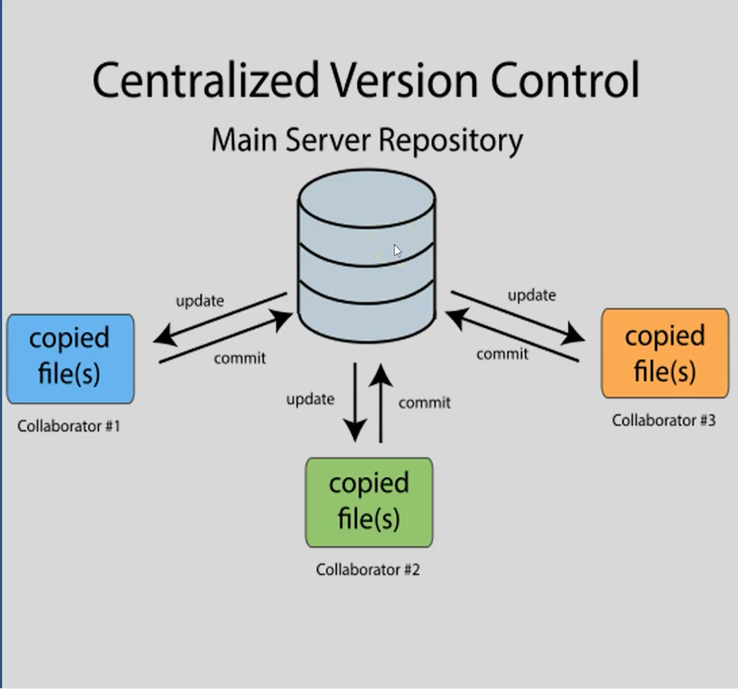
Git - Version Control System
There are two types of Version Control Systems (VCS):
Centralized Version Control Systems:
In CVCS, each developer typically checks out files from a central repository to their local machine.
They modify files locally and then commit changes back to the central repository.
However, the version history and control over changes are centralized on the server.

Slide 9
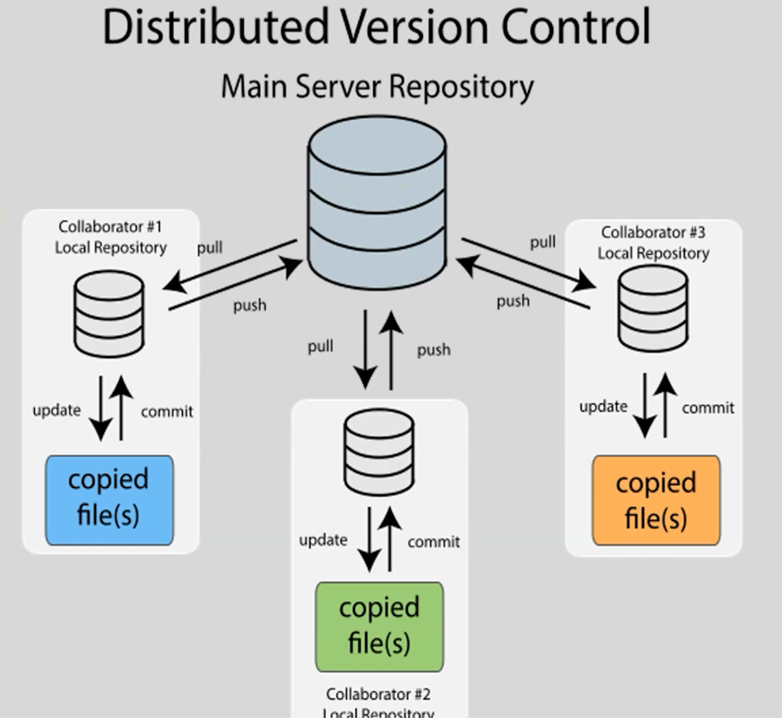
Git - Version Control System
Distributed Version Control System:
In contrast, DVCS like Git allows each developer to have a complete copy of the repository, including its entire history, on their local machine.
This means developers can work independently, create branches, commit changes, and merge changes locally without immediate dependency on a central server.
They can later synchronize their changes with others' repositories as needed.

Slide 10
Git - Version Control System
Git is a distributed version control tool.
Version control is a system that records changes to a file or set of files or codebase over time so that you can revert to specific versions later.
In the realm of Git, a commit means a snapshot of file/set of files/codebase.
A commit includes the changes made over the previous commit and stores a pointer to the previous commit (version control).
A codebase combined with its entire commit history is called a repository.

Slide 11
Git - Version Control System
Linus Torvalds created Git in 2005, and it was built around the Linux operating system and MacOS.
These operating systems have a built-in bash shell that allows Git to run smoothly.
On the other hand, Windows is not a UNIX-based system and uses a different shell from bash, which git doesn't support out of the box.
To bridge the gap, Git Bash was created.

Slide 12
Git - Version Control System
Git Bash is one of the most popular packages on Windows system and comprises of Git and Bash.
Git bash installs both git and bash shell on a Windows system giving it access to command line tools that allow git to run properly.
Additionally, git bash also installs bash tools such as ssh, cat, nano that makes developing on Windows easier.

Slide 13
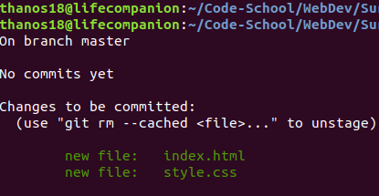
Git - Version Control System

Slide 14
Git - Version Control System
GitHub is a hosting service for Git repositories.
It adds a web-based interface and additional collaboration features on top of Git.
Developers can push their local Git repositories to GitHub, where others can access, contribute to, and collaborate on the codebase for issue tracking, pull requests and project boards.
Other examples are :
GitLab, Bitbucket, Azure DevOps Repos, AWS CodeCommit.

Slide 15
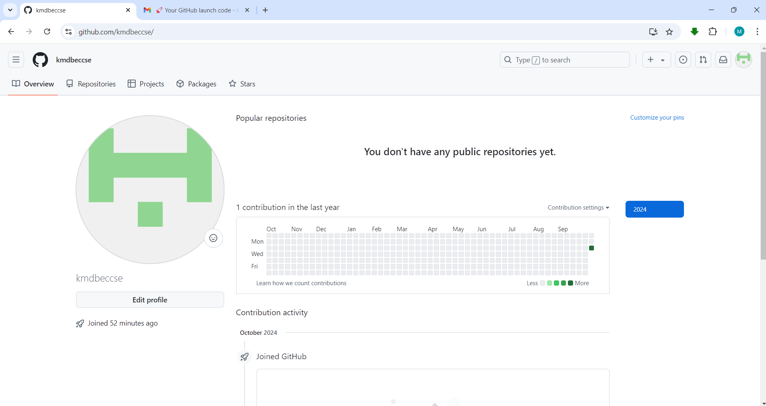
Git - Version Control System

Slide 16
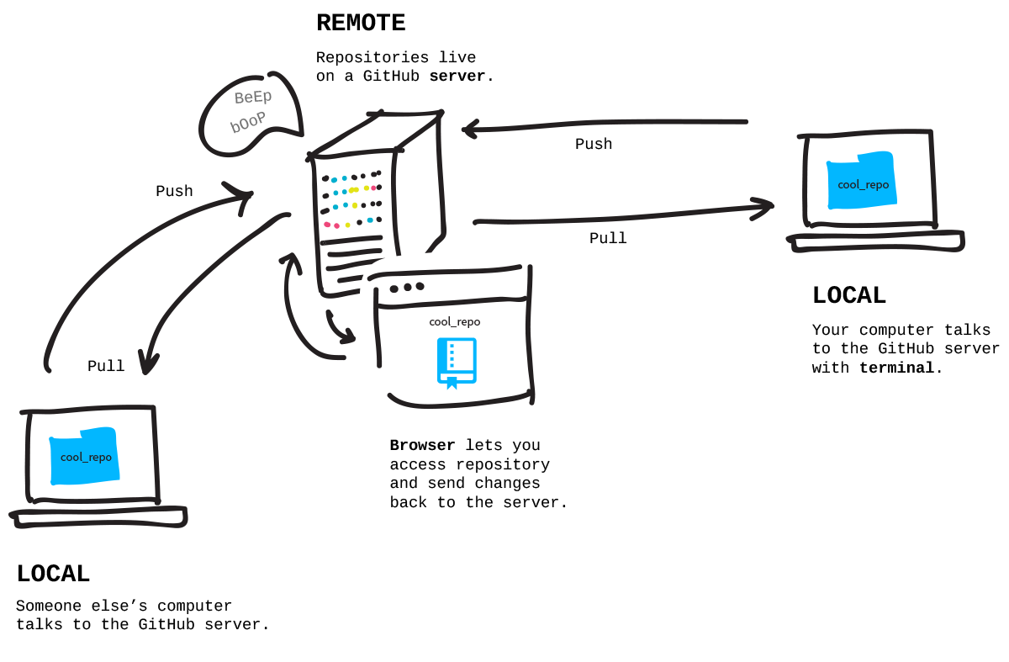


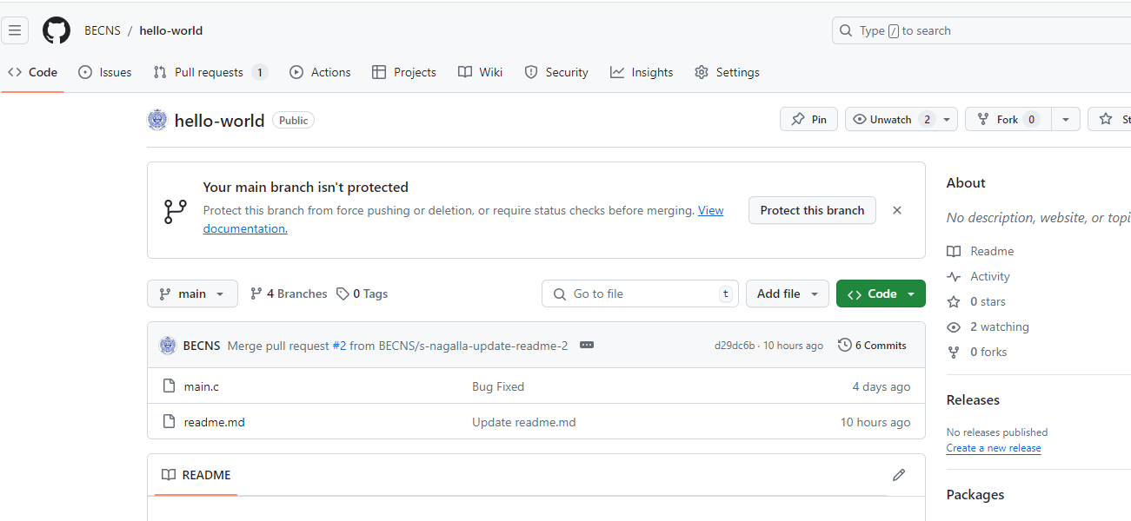
Git-GitHub

Slide 17
Git

Slide 18
Git - Workflow
Initial Steps
Install Git
Configure Git- only once
Create a GitHub account
$ git config --global user.name "Your Name"
$ git config --global user.email "your.email@example.com"

Slide 19


Git - Workflow
Local System
Working Directory
Staging Area
Local Repository
Remote Repository
git clone
git add
git commit
git commit -a
git push

Slide 20
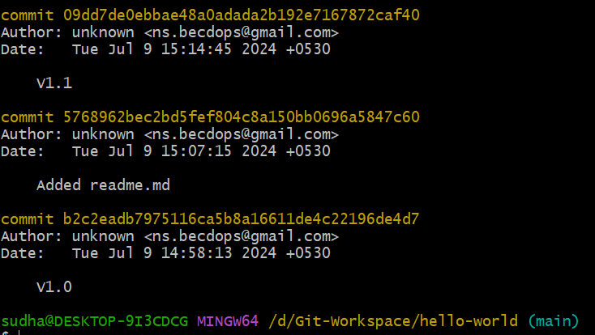
Git - Workflow
The git log command is used to view the history of commits in a Git repository.
It prints commit hash, author, date, and commit message – latest on top.
Several options customize the output

Slide 21
Git - Workflow
git log –n 3 shows the last 3 commits.
git log –-pretty="%h : %s" prints abbreviated hash and commit message.
git log –-oneline shows a summary of commits with one line per commit.
git log –-graph shows a text-based graphical representation of the commit history.

Slide 22
Git - Workflow
Git maintains a pointer HEAD that points to the latest commit on the current branch (main) you're working on.
git show HEAD
Prints the details of the latest commit to which HEAD is pointing to.
git show HEAD~1
Prints the details of the previous commit relative to the commit what HEAD is pointing to.
git show HEAD~<n>

Slide 23
Git - Workflow
A commit is identified by a unique SHA-1 (Secure Hash Algorithm – 1) hash.
This hash is a 40-hex character string. It is a 160-bit (20-byte) code.
Normally, first six characters are good enough to refer to a commit. With this code, one can revert back to a specific commit state.
It is generated based on the contents of the commit, including metadata such as the author, timestamp, and the commit message, as well as the actual changes made in the commit.

Slide 24
Git - Workflow
Branch
When a repository is cloned or created locally, the working directory code is on main branch.
In the realm of Git, main branch is the default stable branch where the production-ready code resides.
Developers work on new features or bug fixes in separate branches.
These branches are merged into the stable branch after they have been thoroughly tested.

Slide 25
Git - Workflow
Local System
Upstream/Remote tracking branches
The main branch in the local repository is set up to track the remote origin/main branch.
origin is the name given for the remote repository cloned.
main is the branch on the remote repository.
Every local branch is associated with a remote tracking branch.
Working Directory
Staging Area
Local Repository
Remote Repository
main
origin/main

Slide 26
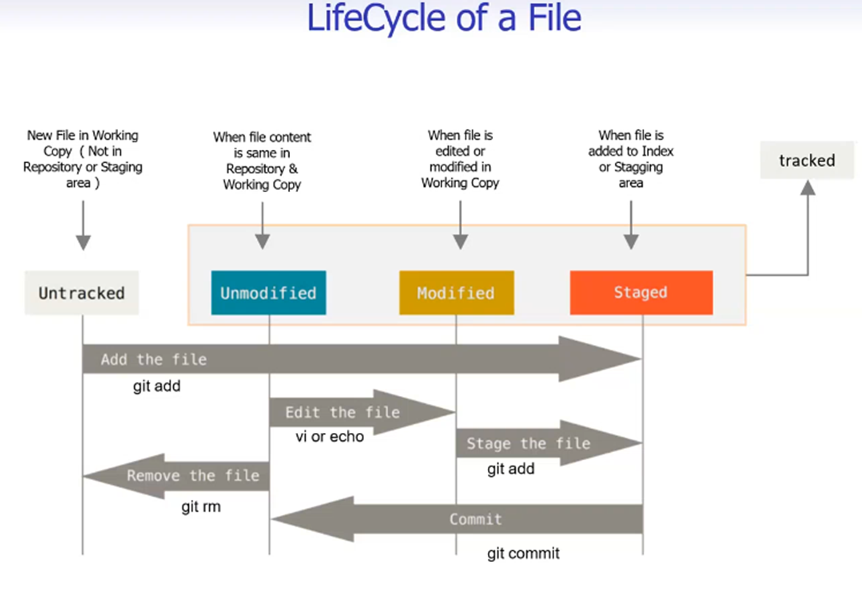
Git - Workflow
Local Repository
git commit

Slide 27
Git - Workflow
git remote –v
The command outputs the name of the remote repository and its URL.
git branch
The command outputs the current branch.
git branch –vv
The command outputs the local branches and the corresponding remote tracking branches.
Local System
Working Directory
Staging Area
Local Repository
Remote Repository
main
origin/main

Slide 28
Git - Workflow
File Status
A file after commit becomes an unmodified file indicating that the versions of the file in the staging area and in the repository are same.
If changes are made to a staged file it becomes modified.
Such a file needs to be staged and committed to move it to the local repository.

Slide 29
Git - Workflow
At times, you may start from a local working directory, stage, commit and then push the local repository to the remote repository.
The Git work-flow in such a case would be.
Create and initialize a local repository.
$ mkdir my-project
$ cd my-project
$ git init

Slide 30
Git - Workflow
Create and stage files.
Create a Remote Repository on GitHub and copy the URL.
Link the Local Repository to Remote and push the changes:
$ vi new-file
$ git add .
$ git commit –m "commit message"
$ git remote add origin https://github.com/your-username/my-project.git
$ git push origin main

Slide 31
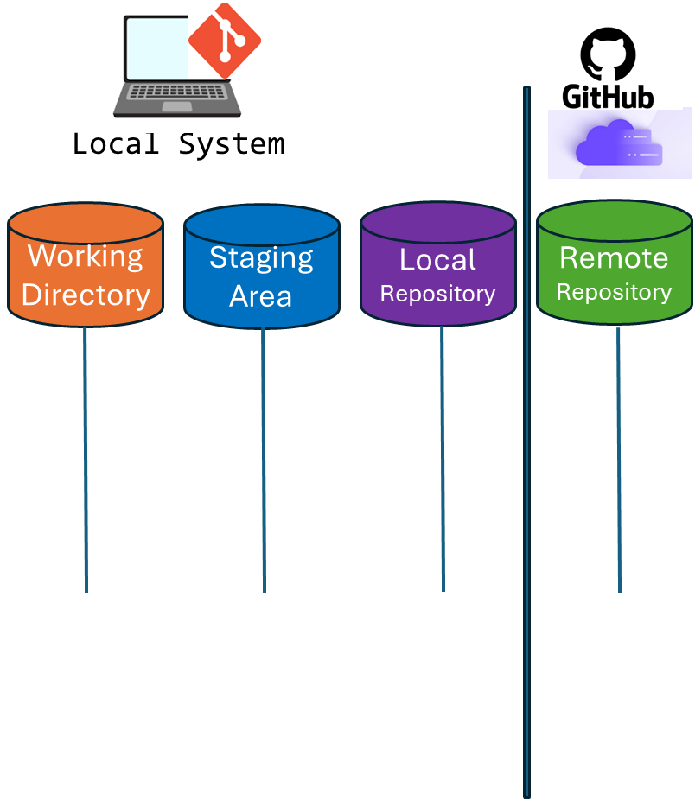
Git - Workflow
There is a third use case using git pull command. The pull command updates local repo, stage area and the working directory from the remote repo.
git pull
$ mkdir my-project
$ cd my-project
$ git init
$ git remote add origin <remote-repo-url>
$ git pull origin main

Slide 32
Git - Workflow
Another equivalent sequence of commands to pull command consists of two commands.
git fetch
This command updates the remote-tracking branches in the local repository (e.g., origin/main) with the latest changes from the remote repository.
But it does not modify the working directory or staging area.
git pull
git fetch

Slide 33
Git - Workflow
git checkout main
This command switches to a branch that has been updated by git fetch and the working directory and staging area will be updated to reflect the state of that branch.
If you are already on the branch Another alternative to this command is git merge main.
git pull
git fetch
git checkout main
git merge main

Slide 34
Git - Workflow
$ git fetch
$ git checkout main
git pull
$ git fetch
$ git merge main
git fetch
git checkout main
git merge main

Slide 35
Git - Workflow
Create and stage files.
Create a Remote Repository on GitHub and copy the URL.
Link the Local Repository to Remote and push the local reopo.
$ vi new-file
$ git add .
$ git commit –m "commit message"
$ git push -u origin main

Slide 36
Git - Workflow
Tracking the changes:
Shows the differences between your working directory and the staging area.
Shows the differences between your working directory and the last commit / repository. This includes both staged and un-staged changes.
Local System
$ git diff
Working Directory
Staging Area
Local Repository
Remote Repository
git diff
$ git diff HEAD
git diff HEAD

Slide 37
Git - Workflow
The git mv command moves or renames files and directories, and it stages the changes for the next commit.
Local System
Working Directory
Staging Area
Local Repository
Remote Repository
git mv/rm
$ git mv old_filename.txt new_filename.txt
$ git mv filename.txt new_directory
$ git mv old_filename.txt new_directory/new_filename.txt

Slide 38
Git - Workflow
The git rm command is used to remove files or directories from the working directory and the staging area, ensuring that the removal is tracked in the next commit.
Local System
Working Directory
Staging Area
Local Repository
Remote Repository
git mv/rm
$ git rm filename.text
$ git rm -r directory_name
$ git rm --cached filename.txt – removes from staging area

Slide 39
Git - Workflow
The git reset <file> un-stages <file> but leaves the working directory unchanged.
If you have accidentally staged some files that you do not want to commit yet, you can use git reset to unstage them.
Local System
Working Directory
Staging Area
Local Repository
Remote Repository
$ git reset filename.text
git reset

Slide 40
Git - Workflow
The git reset <file> un-stages <file> but leaves the working directory unchanged.
If you have accidentally staged some files that you do not want to commit yet, you can use git reset to unstage them.
Local System
Working Directory
Staging Area
Local Repository
Remote Repository
$ git reset filename.text
git reset

Slide 41
Git - Workflow
The git reset <commit> can modify the state of working directory, the staging area, and the commit history. It can be used with different optios.
--soft. This option moves the HEAD pointer to a specified commit but leaves the staging area (index) and working directory unchanged.
Local System
Working Directory
Staging Area
Local Repository
Remote Repository
git reset <commit>

Slide 42
Git - Workflow
--mixed (default). This option moves the HEAD pointer to a specified commit and updates the staging area (index) and leaves working directory unchanged.
--hard. This option moves the HEAD pointer to a specified commit and updates the staging area (index) and working directory.
Local System
Working Directory
Staging Area
Local Repository
Remote Repository
git reset <commit>

Slide 43
Git - Workflow
git reset HEAD.
Unstages the changes but keeps the changes in the working directory.
git reset -–hard HEAD~1
Commit, Staging and working folder are rolled back to the previous commit state.
git reset --soft c3d4e5f6
Local System
Working Directory
Staging Area
Local Repository
Remote Repository
git reset <commit>

Slide 44
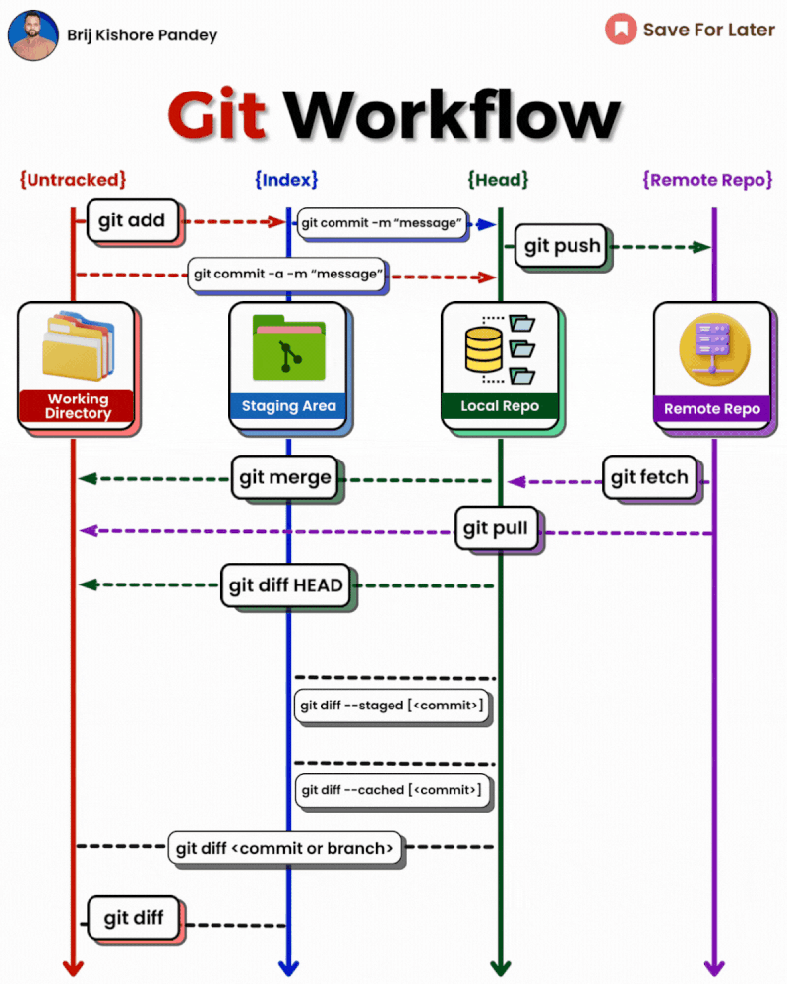

Slide 45

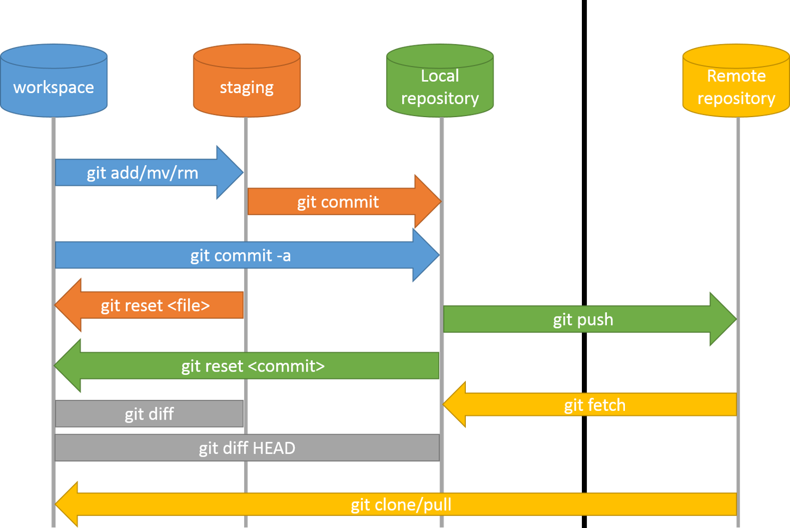
Git - Workflow

